Slide 1
Probability and Statistics
Prepared by
Sajana Shakya

Slide 2
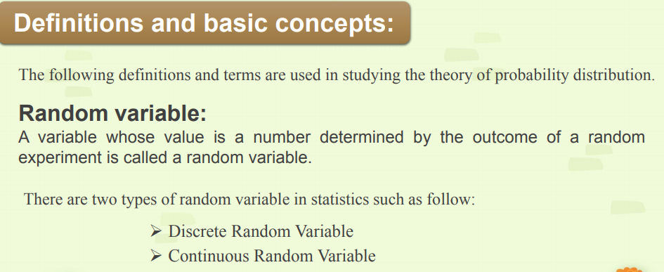

Slide 3
Discrete Random Variable
Things that you can count is discrete.
For eg.
1. No. of telephone calls per unit time
2. Year that randomly chosen student was born
3. No. of customer visited in the store
4. No. of defective items in the box of 10
Discrete Random variable maps to either a finite set or countably infinite set.

Slide 4
In coin tossing experiment
S={Head,Tail} let X be a discrete R. V. then
X = {1,0}
In raining process
S={rain, no rain}
X={20, 30}
Let X be a discrete R. V. which represents number of students present in the class tomorrow X={0,1,2,…48}

Slide 5
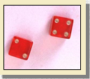
Rolling a fair dice
S={1,2,3,4,5,6}
Suppose a dice is rolled repeatedly
X= no. of 2s before observing 4 on the upper face then
X={0,1,2,3,………} which is countable but infinite

Slide 6
Continuous Random Variable
Things that you measured but not by counting
For example :
Height or weight of randomly chosen person
Duration of telephone calls
Time taken to run a mile
Amount of rainfall
Waiting time for 5 customers
Temp. set in a machine (18-22) ◦C
Diameter of a bolt (1.8-2.2)cm

Slide 7
# Continuous RV maps to uncountably Infinite set.
X=Amount of rainfall in inches (recorded as 1”)
Y= Height of randomly chosen person (6 ft)
# Discrete RV takes distinct and separate values.
#Continuous RV takes values within certain interval.

Slide 8
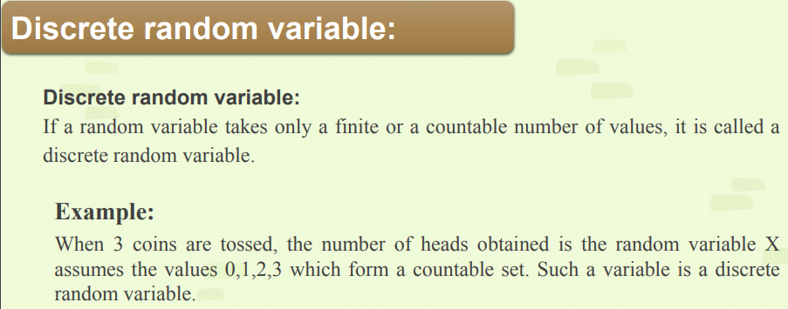

Slide 9
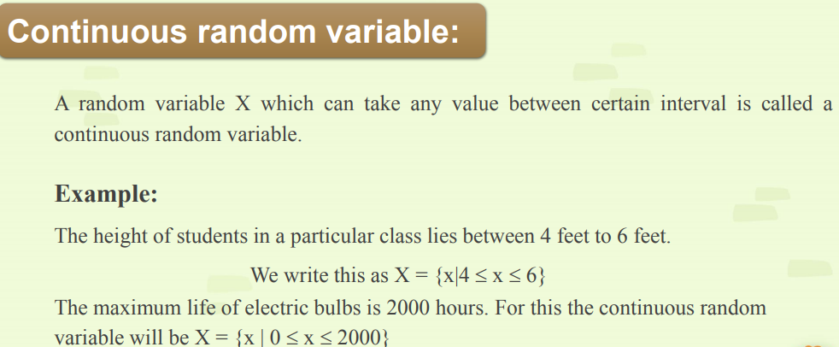

Slide 10
Difference between Discrete RV and Continuous RV
Discrete RV represents counted data
Discrete RV take only integral value, So to study properties of these variables, tools of mathematics summation and difference are required
We can list all possible values of a discrete RV.
Probability distribution of a discrete RV can be presented in a tabular form.
Continuous RV represents measured data
Continuous RV take any real number in the interval, so to study these variables required calculus (Integration and derivative)
We can not list all possible values of a continuous RV.
Probability distribution of a continuous RV can not be presented in a tabular form. It has either a formula form or a graphical form

Slide 11
Probability Distribution
Two types of Probability Distribution
Discrete Probability Distribution
Continuous Probability Distribution

Slide 12
Probability Mass Function
It is a function which gives probability that the value of a random variable is exactly equal to some specified value.
Let X be a discrete random variable then Pi or P(x_{i}) or P(X=x_{i}) is said to be p.m.f. if it satisfies the following conditions or properties.
0 ≤ P(x_{i}) ≤ 1
Σ P(x_{i}) = 1

Slide 13

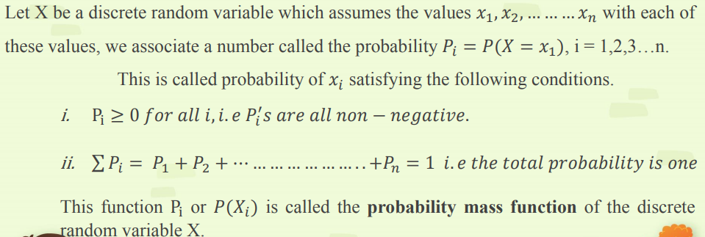

Slide 14
Probability Distribution
A Probability distribution is an equation or table or graph that assigns probability to every possible outcome of a random experiment.
In simple words,
A probability distribution gives probability for each possible value of a random variable

Slide 15
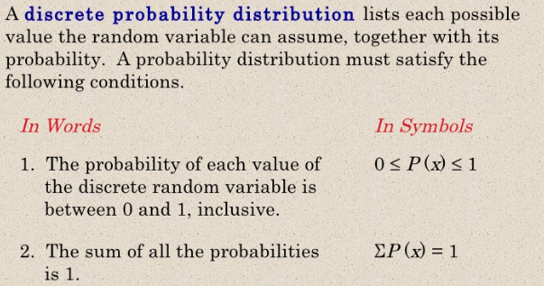

Slide 16
Suppose tossing a coin two times
The sample space is
S = {HH,HT,TH,TT}
Let X be a discrete RV Which represents number of heads then
X={0,1,2}
P(X=x)=C(n,x) P^{x} Q^{n-x}
X | P(X=x)
0 | 0.25
1 | 0.5
2 | 0.25

Slide 17
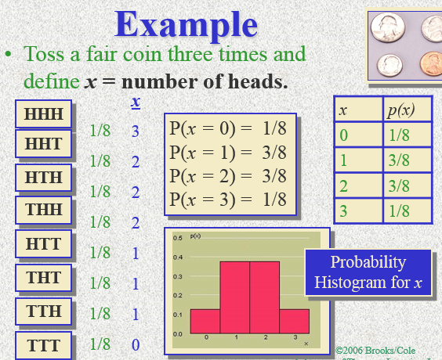

Slide 18
Cumulative distribution function refers to the probability that the value of a Random Variable falls within a specified range.
For eg. In the experiment tossing coin two times
F(x)=P(X≤ x)
F(1)=P(X ≤1)
=P(X=0)+P(X=1)
=0.25+0.5
=0.75
# c.d.f. is also called Probability distribution function or distribution function or cumulative probability

Slide 19
Properties of Cumulative distribution function
0 ≤F(x) ≤1
F(-∞) = P(X ≤-∞) = 0
F(+∞) = P(X ≤ +∞) = 1
Let x₁ and x₂ are possible values of a random variable X, If x₁ ≤ x₂ then F(x₁) ≤ F(x₂)
P(a < X ≤ b)= F(b) – F(a)

Slide 20
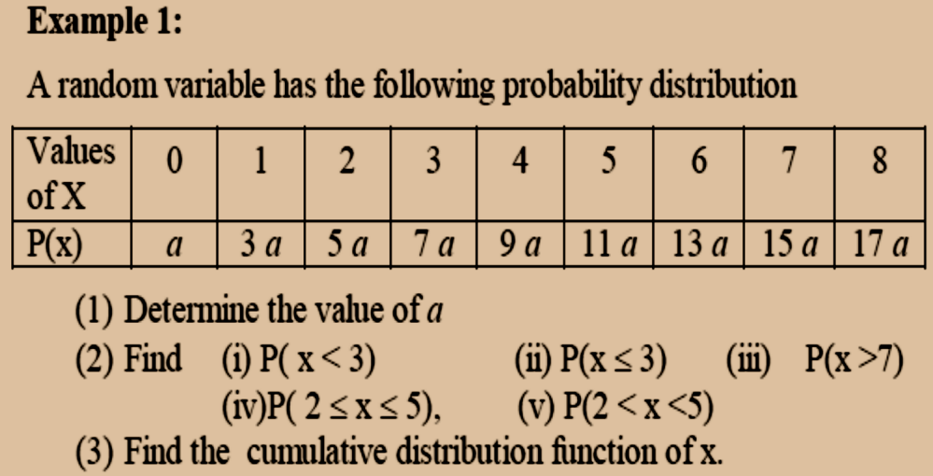

Slide 21
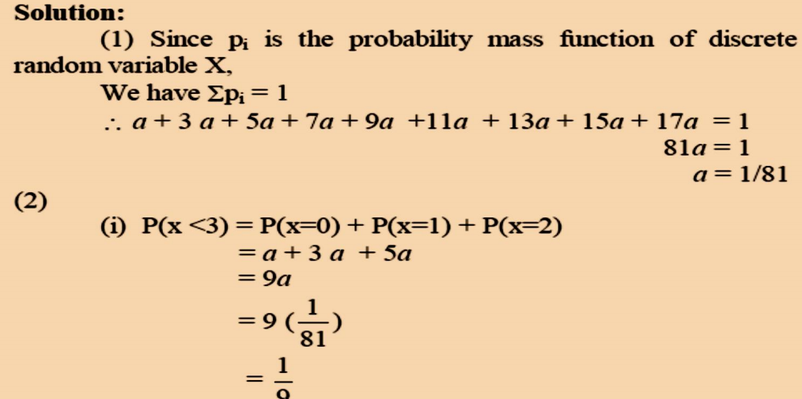

Slide 22
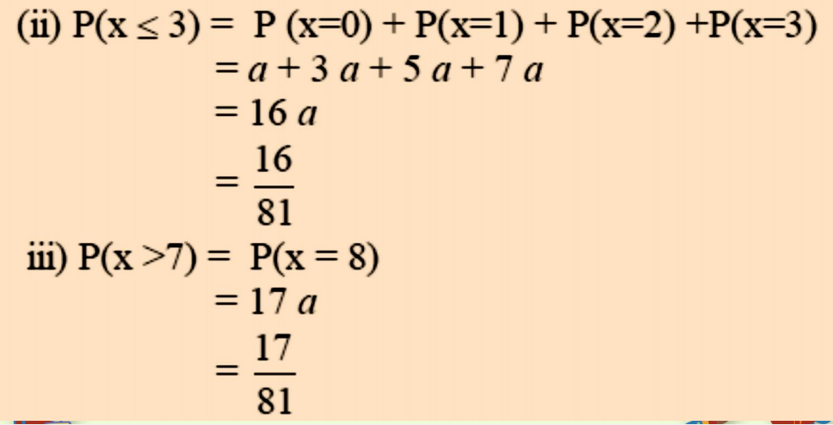

Slide 23
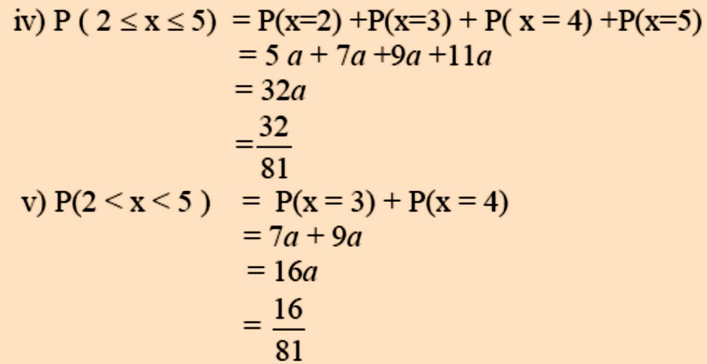

Slide 24
3) For Cumulative distribution function of X
Value of X | 0 | 1 | 2 | 3 | 4 | 5 | 6 | 7 | 8
P(X=x) | 1/81 | 3/81 | 5/81 | 7/81 | 9/81 | 11/81 | 13/81 | 15/81 | 17/81
F(x) = P(X ≤ x) | 1/81 | 4/81 | 9/81 | 16/81 | 25/81 | 36/81 | 49/81 | 64/81 | 81/81

Slide 25
Expected values(Mean) and Variance of a Random Variable:
The average value of all possible values of a random variable is called Mathematical Expectation or mean of a random variable. It is denoted by E(X) or µ
For eg. Tossing a coin 100 times
X= Number of heads
X = {0,1,2,3,…………100)
E(X) = Average number of heads

Slide 26
For Discrete Random variable
Mean = µ = E(X) = Σ x. P(X=x)
For Discrete Random variable
Variance=σ² =E(X²)-[E(X)]²
E(X²) = Σx².P(X=x)
X=x | P(X=x) | x. P(X=x)
 | Σ P(X=x)=1 | Σ x. P(X=x)

Slide 27
Properties of E(X)
E(a) = a
E(X₁+X₂+……..+X_{n}) = E(X₁)+E(X₂)+…….E(X_{n})
E(X₁.X₂.……..X_{n}) = E(X₁).E(X₂).…….E(X_{n})
E(aX) = a E(X)
E(aX+b) = a E(X) + b

Slide 28
Properties of V(X)
V(a) = 0
V(aX) = a² V(X)
V(aX+b)= a² V(X)
V(X+X) = V(2X) = 4V(X)
V(X ± Y) = V(X) ± V(Y) if X and Y are independent

Slide 29
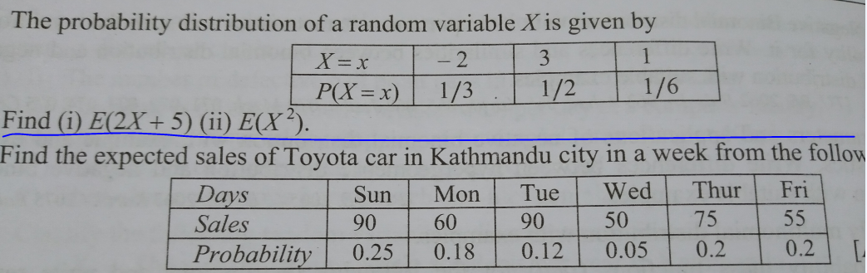

Slide 30
